Slide 1
HTML
Tables

Slide 2
Tables
Tables can be used to display rows and columns of data, create multi-column text, captions for images, and sidebars
The <TABLE> tag is used to create a table; the <TR> tag defines the beginning of a row while the <TD> tag defines the beginning of a cell

Slide 3
<table>
Tables use a very simple tag structure with these four sub-elements:
Table Row <TR>…</TR>.
Table Header <TH>…</TH>.
Table Data <TD>…</TD>.

Slide 4
<table> attributes
<TABLE ALIGN=“left" BORDER=0 BGCOLOR=“cyan“ width=600 cellpadding=0 cellspacing=0>
Align: "left", "center" or "right“ - "left" is the default
Border: thickness of the border in pixels - 0 for no borders
Bgcolor: is background color in HEX or as a name color
Background=url (works with IE only)
Cellpadding=n (n is number of pixels (space) between cell content and its border
Cellspacing=n (n is number of pixels (space) between cells)
Height=n (height of table in pixels or percentages 100%)
Width=n (Width of table in pixels or percentages 100%)

Slide 5
Adding a Border
The BORDER=n attribute allows you to add a border n pixels thick around the table
To make a solid border color, use the BORDERCOLOR=“color” attribute

Slide 6

Creating Simple Table
<TABLE BORDER=10>
<TR>
<TD>One</TD>
<TD>Two</TD>
</TR>
<TR>
<TD>Three</TD>
<TD>Four</TD>
</TR>
</TABLE>
Here’s how it would look on the Web:

Slide 7
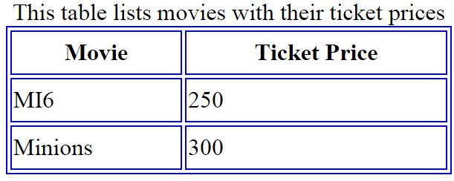
<TABLE BORDER="1" WIDTH="300" HEIGHT="100" BORDERCOLOR="BLUE">
<CAPTION ALIGN="TOP" >This table lists movies with their ticket prices</CAPTION>
<TR >
<TH>Movie</TH>
<TH>Ticket Price</TH>
</TR>
<TR>
<TD>MI6</TD>
<TD>250</TD>
</TR>
<TR>
<TD>Minions</TD>
<TD>300</TD>
</TR>
</TABLE>

Slide 8
Centering a Table
There are two ways to center a table
Type <TABLE ALIGN=CENTER>
Enclose the <TABLE> tags in opening and closing <CENTER> tags

Slide 9
Controlling Cell Spacing
Cell spacing is the space between cells while cell padding is the space around the contents of a cell
To control both types of spacing, use the CELLSPACING =n and CELLPADDING=n attributes in the <TABLE> tag

Slide 10
TD or TH Attributes
Colspan: Specifies how many cell columns of the table this cell should span.
Rowspan: Specifies how many cell rows of the table this cell should span.
Align: cell data can have left, right, or center alignment.
Valign: cell data can have top, middle, or bottom alignment.

Slide 11
<table border=1 cellpadding =2>
<tr>
<th> Column 1 Header</th>
<th> Column 2 Header</th>
</tr>
<tr>
<td colspan=2> Row 1 Col 1</td>
</tr>
<tr>
<td rowspan=2>Row 2 Col 1</td>
<td> Row 2 Col2</td>
</tr>
<tr>
<td> Row 3 Col2</td>
</tr> </table>

Slide 12
Output
Column 1 Header | Column 2 Header
Row 1 Col 1
Row 2 Col 1 | Row 2 Col 2
 | Row 3 Col 2
‹#›

Slide 13
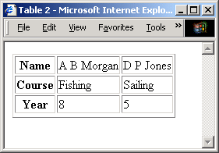
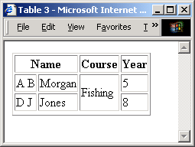
Tables
Row –column format
<table border="1">
<tr>
<th>Name</th>
<td>A B Morgan</td>
<td>D P Jones</td>
</tr>
…
<table border="1">
<tr>
<th colspan="2">Name</th>
<th>Course</th>
<th>Year</th>
</tr>
....
....
‹#›

Slide 14
Changing a Cell’s Color
To change a cell’s color, add the BGCOLOR=“color” attribute to the <TD> tag
Example:
<TD BGCOLOR=“blue”>

Slide 15
Controlling Line Breaks
Unless you specify otherwise a browser will divide the lines in a cell as it sees fit.
The NOWRAP attribute placed within the <TD> tag forces the browser to keep all the text in a cell on one line
Example:
<TD NOWRAP>Washington, D.C.

Slide 16
Nesting Tables
Create the inner table
Create the outer table and determine which cell of the outer table will hold the inner table
Test both tables separately to make sure they work
Copy the inner table into the cell of the outer table
Don’t nest too many tables. If you find yourself doing that, find an easier way to lay out your Web page

